Slide 1
Reinforcement Learning for 2048
Deep Learning and Practice 2019 spring
Department of Computer Science, NCTU
Author: Hung Guei
Speaker: Kuo Hao

Slide 2
Outline
2048 game
Q-Learning
TD-Afterstate
N-Tuple network
2048 framework

Slide 3


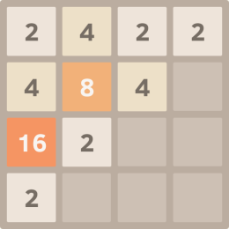
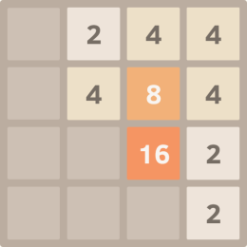
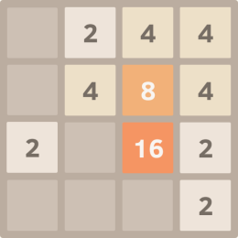
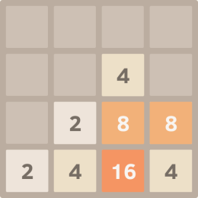
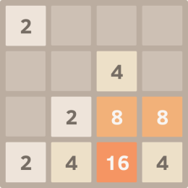
Episode & States
Terminology
.
.
.
beforestate
afterstate
.
.
.
$$s_{t}$$
$$s_{t}^{′}$$
$$s_{t+1}$$
$$s_{t+1}^{′}$$
$$↑$$
action
performed
new tile
popup
action
performed
$$a_{t}$$
$$a_{t+1}$$
$$+r_{t}$$
$$+r_{t+1}$$
$$→$$
.
.
.
$$↓$$
$$←$$
.
.
.
Perform an action (↑ → ↓ ←)
A new tile randomly appear
Notes:
+ popup line

Slide 4
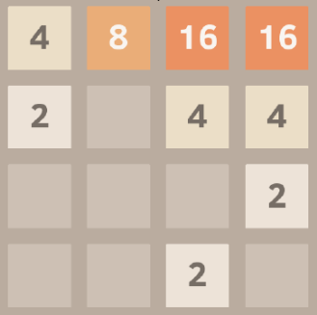
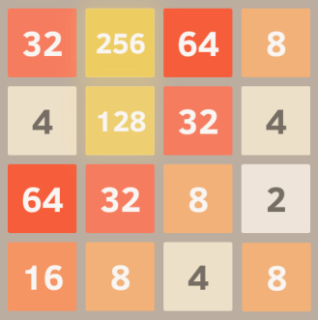

Estimated Value
Terminology
Estimated value $V(s)$of a 2048 state $s$is the expected sum of rewards from current state to terminal state.
$$V\left(s_{t}\right)=𝔼\left[r_{t}+r_{t+1}+r_{t+2}+…\right]$$
Estimated value > 0
Estimated value = 0

Slide 5
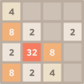

Q-Learning Network
Q-Learning
Input: $s$
A $state$
Output: $Q\left(s,a\right)$
The expected value for applying $action$ $a$ on $state$ $s$
$$Q\left(s_{t},↑\right)$$
$$s_{t}$$
$$a_{t}$$
$$Q\left(s_{t},→\right)$$
$$Q\left(s_{t},↓\right)$$
$$Q\left(s_{t},←\right)$$
Notes:
We used both Q-learning and TD(0) as the reinforcement learning component of our network updates. In a game of 2048, such as the example illustrated in Figure 2, the player chooses an action
To do this, the program plays through a game of 2048, and records the tuple $\left(s, a, r, s′′\right)$ for each action performed. Once the game ends, equation (1) is used for each tuple to train the network.

Slide 6

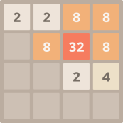
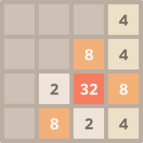
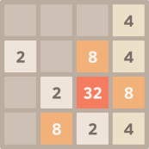
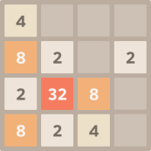
Use Q-Learning Network
Q-Learning

Slide 7

Update Q-Learning Network
Q-Learning
Play an episode of 2048, record the tuple $\left(s_{t}, a_{t}, r_{t}, s_{t+1}\right)$ for each action performed.
Then, update from these tuples based on the following:
$$Q\left(s_{t},a_{t}\right)←Q\left(s_{t},a_{t}\right)+α\left(r_{t}+\max_{a_{t+1}}{Q\left(s_{t+1},a_{t+1}\right)}−Q(s_{t},a_{t})\right)$$
$$Q\left(s_{t},↑\right)$$
$$s_{t}$$
$$a_{t}$$
$$update$$
$$Q\left(s_{t},→\right)$$
$$r_{t}+\max_{a_{t+1}}{Q\left(s_{t+1},a_{t+1}\right)}$$
$$Q\left(s_{t},↓\right)$$
$$Q\left(s_{t},←\right)$$
Notes:
We used both Q-learning and TD(0) as the reinforcement learning component of our network updates. In a game of 2048, such as the example illustrated in Figure 2, the player chooses an action
To do this, the program plays through a game of 2048, and records the tuple $\left(s, a, r, s′′\right)$ for each action performed. Once the game ends, equation (1) is used for each tuple to train the network.
+ color group

Slide 8

Update Q-Learning Network
Q-Learning
.
.
.
beforestate
afterstate
.
.
.
$$s_{t}$$
$$s_{t}^{′}$$
$$s_{t+1}$$
$$s_{t+1}^{′}$$
$$↑$$
action
performed
new tile
popup
action
performed
$$a_{t}$$
$$a_{t+1}$$
$$+r_{t}$$
$$+r_{t+1}$$
$$→$$
.
.
.
$$↓$$
$$←$$
.
.
.
$$Q\left(s_{t},a_{t}\right)=𝔼\left[r_{t}+r_{t+1}+r_{t+2}+…\right]$$
Perform an action (↑ → ↓ ←)
A new tile randomly appear
Notes:
Q(s, a) is defined as the expected sum of rewards after applying action a on state s.
Not deterministic
Combining the reward corresponding to current action and the expected score of next state, we can calculate a new expected value for Q(s,a) that is more accurate than current Q(s,a)

Slide 9


TD-Afterstate Network
TD-Afterstate
Input: $s′$
An $afterstate$
Output: $V\left(s^{′}\right)$
The expected value for $afterstate$ $s^{′}$
$$s_{t}^{′}$$
$$V\left(s_{t}^{′}\right)$$
Notes:
For TD(0), the case is illustrated in Figure 3. We update the evaluation of any given afterstate $s^{′}$ using the following equation.
The training process is similar to Q-learning, except the tuple recorded is ${(s}^{′}, r, s′′′)$. The neural network output for the TD(0) case differs from the Q-learning case, since it only has a single value for $V(s)$, which is the evaluated score for state $s$.

Slide 10



Use TD-Afterstate Network
TD-Afterstate

Slide 11

Update TD-Afterstate Network
TD-Afterstate
Play an episode of 2048, record the tuple $\left(s_{t}^{′},r_{t+1},s_{t+1}^{′}\right)$ for each action performed.
Update from these tuples based on the following:
$$V\left(s_{t}^{′}\right)←V\left(s_{t}^{′}\right)+α\left(r_{t+1}+V\left(s_{t+1}^{′}\right)−V(s_{t}^{′})\right)$$
$$s_{t}^{′}$$
$$update$$
$$r_{t+1}+V\left(s_{t+1}^{′}\right)$$
$$V\left(s_{t}^{′}\right)$$
Notes:
For TD(0), the case is illustrated in Figure 3. We update the evaluation of any given afterstate $s^{′}$ using the following equation.
The training process is similar to Q-learning, except the tuple recorded is ${(s}^{′}, r, s′′′)$. The neural network output for the TD(0) case differs from the Q-learning case, since it only has a single value for $V(s)$, which is the evaluated score for state $s$.

Slide 12
Update TD-Afterstate Network
TD-Afterstate
.
.
.
beforestate
afterstate
.
.
.
$$s_{t}$$
$$s_{t}^{′}$$
$$s_{t+1}$$
$$s_{t+1}^{′}$$
$$↑$$
action
performed
new tile
popup
action
performed
$$a_{t}$$
$$a_{t+1}$$
$$+r_{t}$$
$$+r_{t+1}$$
$$→$$
.
.
.
$$↓$$
$$←$$
.
.
.
$$V\left(s_{t}^{′}\right)=𝔼\left[r_{t+1}+r_{t+2}+r_{t+3}+…\right]$$
Perform an action (↑ → ↓ ←)
A new tile randomly appear
Notes:
V(s’) is defined as the expected sum of rewards after state s’.

Slide 13
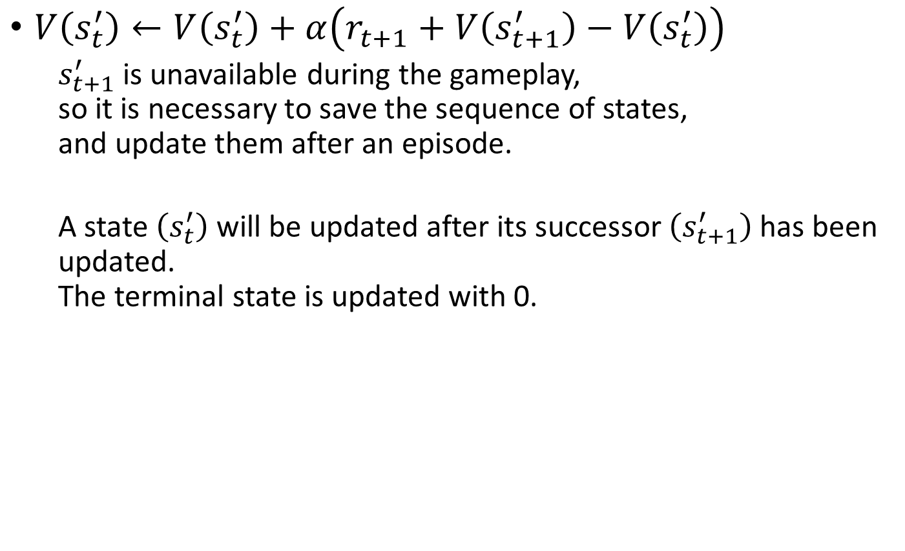
TD-Afterstate Backward Training
TD-Afterstate Training
$V\left(s_{t}^{′}\right)←V\left(s_{t}^{′}\right)+α\left(r_{t+1}+V\left(s_{t+1}^{′}\right)−V\left(s_{t}^{′}\right)\right)$
$s_{t+1}^{′}$ is unavailable during the gameplay, so it is necessary to save the sequence of states, and update them after an episode.
A state $\left(s_{t}^{′}\right)$ will be updated after its successor $\left(s_{t+1}^{′}\right)$ has been updated. The terminal state is updated with 0.

Slide 14
TD-Afterstate Backward Training
TD-Afterstate Training
Step 1: after game over ($s_{t+3}$), update the last state ($s_{t+2}^{′}$)
Step 2: update the previous afterstate ($s_{t+1}^{′}$)
Step 3: update the previous afterstate ($s_{t}^{′}$)
$$s_{t}$$
$$s_{t}^{′}$$
$$s_{t+1}$$
$$s_{t+1}^{′}$$
$$s_{t+2}$$
$$s_{t+2}^{′}$$
$$s_{t+3}$$
$$r_{t}$$
$$r_{t+1}$$
$$r_{t+2}$$
$$0$$
$$s_{t}$$
$$s_{t}^{′}$$
$$s_{t+1}$$
$$s_{t+1}^{′}$$
$$s_{t+2}$$
$$s_{t+2}^{′}$$
$$s_{t+3}$$
$$r_{t}$$
$$r_{t+1}$$
$$r_{t+2}$$
$$s_{t}$$
$$s_{t}^{′}$$
$$s_{t+1}$$
$$s_{t+1}^{′}$$
$$s_{t+2}$$
$$s_{t+2}^{′}$$
$$s_{t+3}$$
$$r_{t}$$
$$r_{t+1}$$
$$r_{t+2}$$

Slide 15
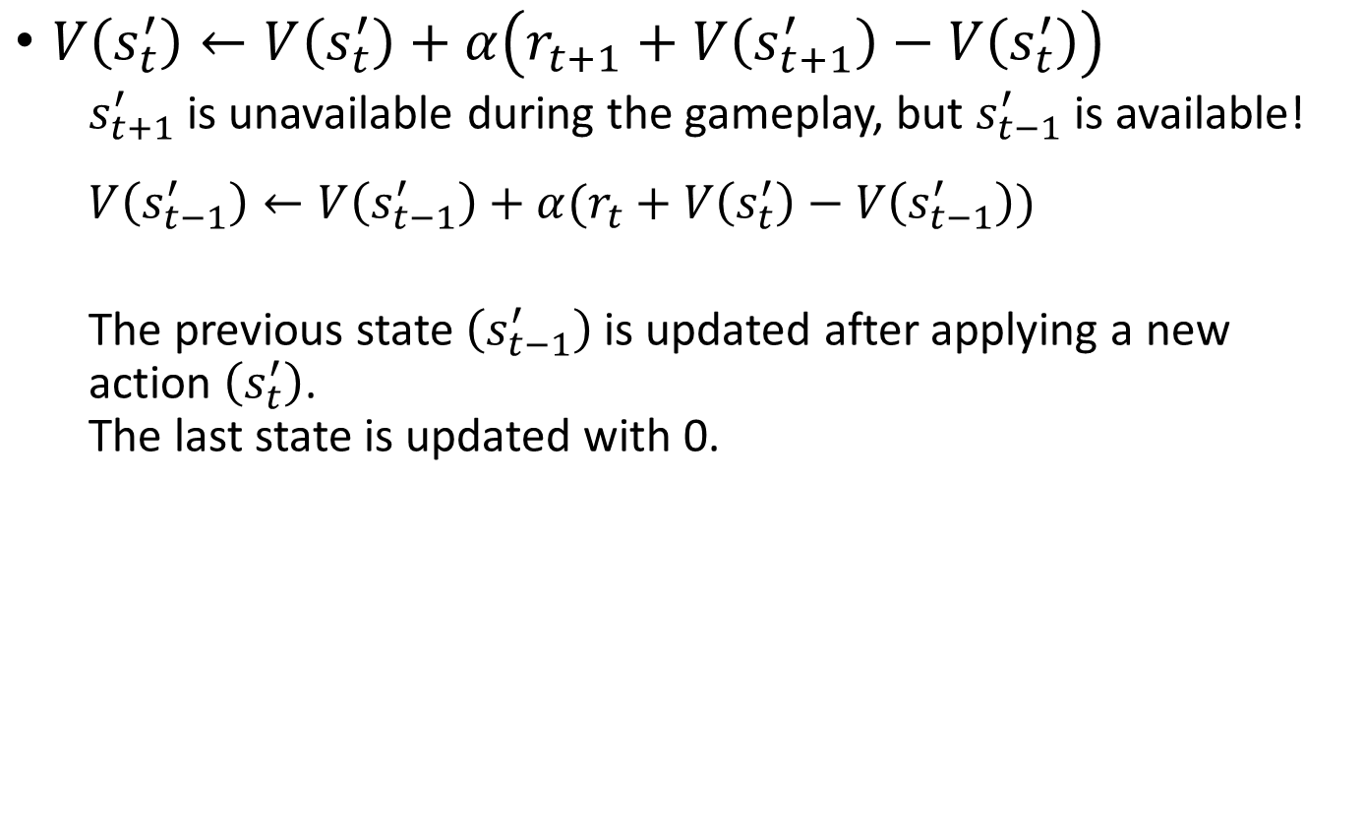
TD-Afterstate Forward Training
TD-Afterstate Training
$V\left(s_{t}^{′}\right)←V\left(s_{t}^{′}\right)+α\left(r_{t+1}+V\left(s_{t+1}^{′}\right)−V\left(s_{t}^{′}\right)\right)$
$s_{t+1}^{′}$ is unavailable during the gameplay, but $s_{t−1}^{′}$ is available!
$$V\left(s_{t−1}^{′}\right)←V\left(s_{t−1}^{′}\right)+α(r_{t}+V\left(s_{t}^{′}\right)−V\left(s_{t−1}^{′}\right))$$
The previous state $\left(s_{t−1}^{′}\right)$ is updated after applying a new action $\left(s_{t}^{′}\right)$. The last state is updated with 0.

Slide 16
TD-Afterstate Forward Training
TD-Afterstate Training
Step 1: apply an action ($s_{t+1}^{′}$), update previous state ($s_{t}^{′}$).
Step 2: apply an action ($s_{t+2}^{′}$), update previous state ($s_{t+1}^{′}$).
Step 3: after game over ($s_{t+3}$), update the last state ($s_{t+2}^{′}$)
$$s_{t}$$
$$s_{t}^{′}$$
$$s_{t+1}$$
$$s_{t+1}^{′}$$
$$s_{t+2}$$
$$s_{t+2}^{′}$$
$$s_{t+3}$$
$$r_{t}$$
$$r_{t+1}$$
$$r_{t+2}$$
$$s_{t}$$
$$s_{t}^{′}$$
$$s_{t+1}$$
$$s_{t+1}^{′}$$
$$s_{t+2}$$
$$s_{t+2}^{′}$$
$$s_{t+3}$$
$$r_{t}$$
$$r_{t+1}$$
$$r_{t+2}$$
$$s_{t}$$
$$s_{t}^{′}$$
$$s_{t+1}$$
$$s_{t+1}^{′}$$
$$s_{t+2}$$
$$s_{t+2}^{′}$$
$$s_{t+3}$$
$$r_{t}$$
$$r_{t+1}$$
$$r_{t+2}$$
$$0$$

Slide 17
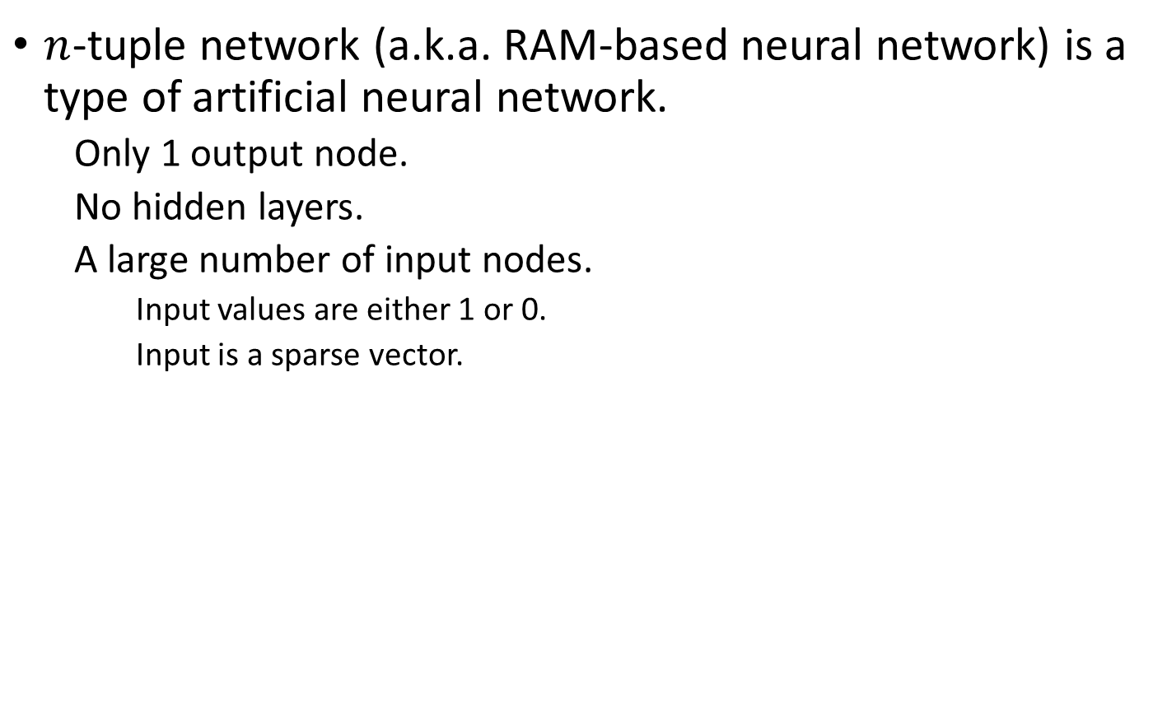
N-Tuple Network
N-Tuple Network
$n$-tuple network (a.k.a. RAM-based neural network) is a type of artificial neural network.
Only 1 output node.
No hidden layers.
A large number of input nodes.
Input values are either 1 or 0.
Input is a sparse vector.
w₀
w₁
w₂
w₃
w₀
w₁
w₂
w₃
…
…
w_{n-4}
w_{n-4}
w_{n-3}
w_{n-2}
w_{n-1}
w_{n-3}
w_{n-2}
w_{n-1}

Slide 18
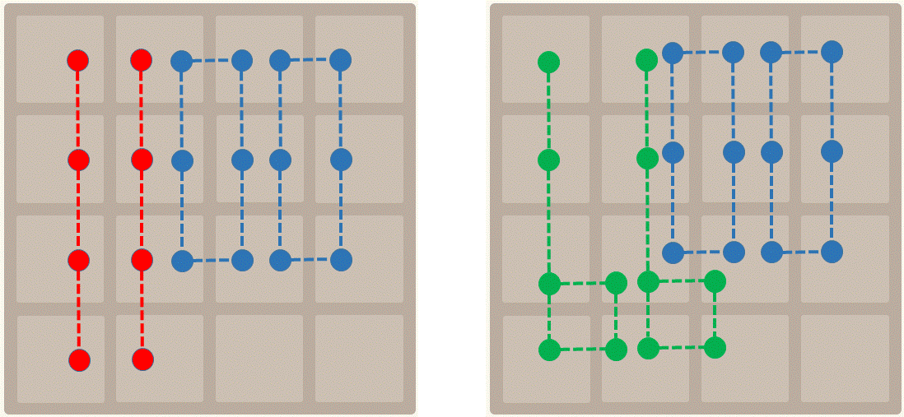
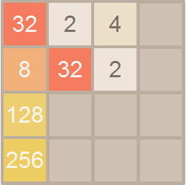

TD-Afterstate & N-Tuple Network
N-Tuple Network
Approximate V(s) with $n$-tuple network.
An explicit value table is computationally infeasible.
Estimated value: $V\left(s_{t}^{′}\right)=Σ_{i}^{m}f_{i}\left(s_{t}^{′}\right)$
Update: $f_{i}^{′}\left(s_{t}^{′}\right)=f_{i}\left(s_{t}^{′}\right)+\frac{α}{m}\left(r_{t+1}+V\left(s_{t+1}^{′}\right)−V\left(s_{t}^{′}\right)\right)$
…
…
0
0.34
0
6.48
-3.14
0.25
0
0
0x735051
1
0
0
0
…
…

Slide 19
2048 framework
Command example:
python3 2048.py --total=20000 --block=5000 --limit=1000 --play=“load=demoTest save=demoTest alpha=0.001”
Command parameters: (refer to 2048.py)
total: Total game episode
block: Show game result summary in N game episode
limit: Clear memory frequence, MUST assign a proper value
play: Player parameters:
{You can adjust or add some parameters}
init: Flag to initialize the weights
load/save: Load/Save weights
alpha: Discount factor

Slide 20
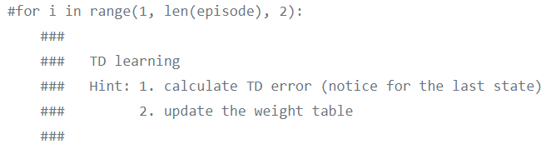
2048 framework
Hint: At least finish those parts in agent.py
Design your weights to get better performance

